Slide 1
Natural History of Arryhthmia after ICD implant -PARTITA lessons
부천세종병원
박상원

Slide 3
Morbidity of shock
Psychological problem
Reduce quality of life
Heart failure acceleration
Proarrythmia (rare)
Modern ICD means the device which could terminate the tachycardia by overdrive pacing with the back up support of shock therapy.

Slide 6
Issue of shock therapy
Minimizing ICD shocks requires a comprehensive approach,
patient selection
general medical care (eg, preventing electrolyte abnormalities)
general cardiac care (preventing ischemia and treating heart failure).
use of antiarrhythmic drugs and catheter ablation both to prevent VT or SVT and to control the ventricular rate in Af
appropriate choice of hardware and device programming
Remote Monitoring

Slide 11
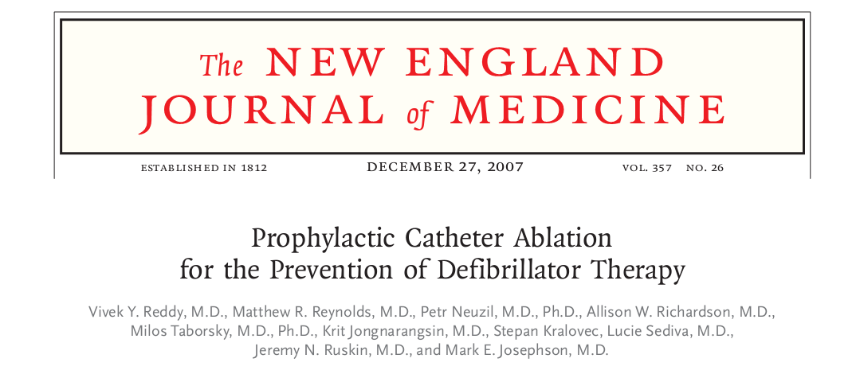
Eligible patients with a history of a MI with ICD for spontaneous VT or VF.
Control vs adjunctive catheter ablation (64 patients in each group)
The primary end point: survival free from any appropriate ICD therapy

Slide 12
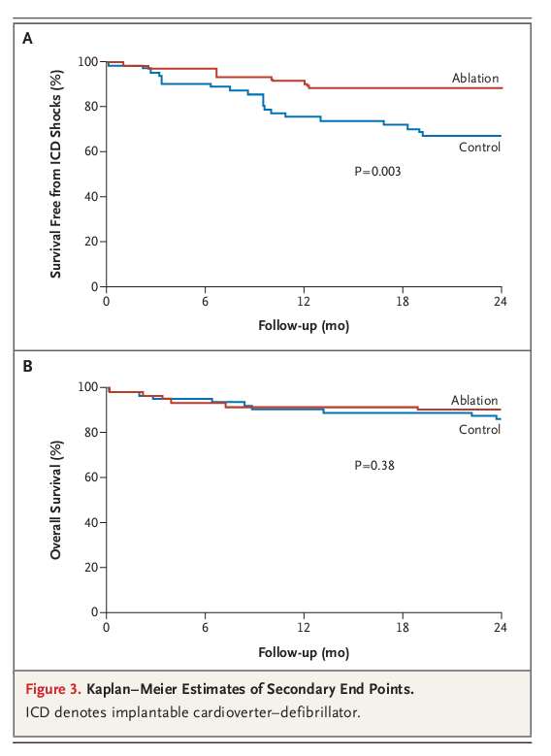
a 65% reduction in the
risk of receiving ICD therapy
a trend toward decreased mortality in the ablation group
(9% vs. 17%, P = 0.29)

Slide 13
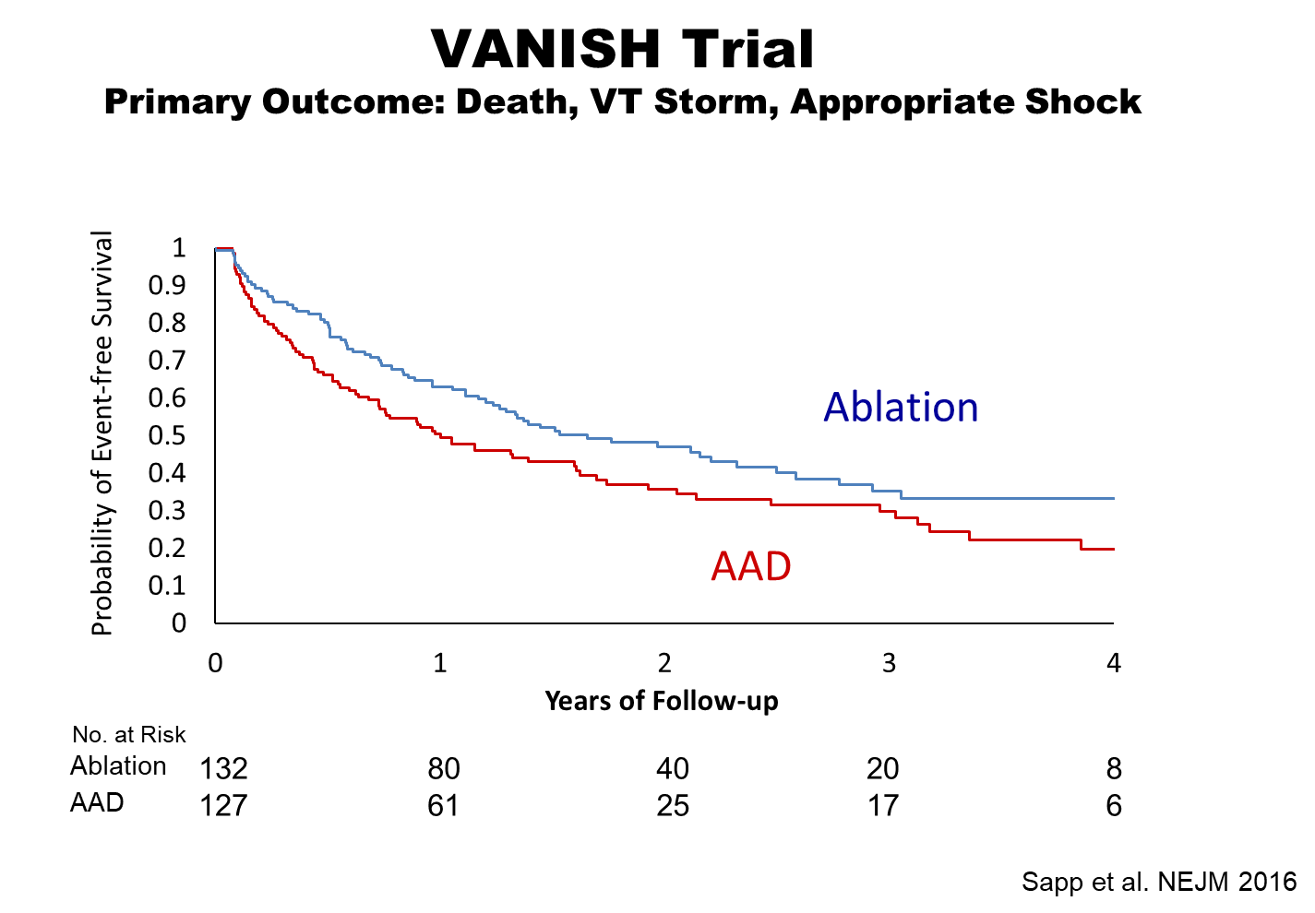

Slide 16
AAD for VT in ICD recipients
The only drugs that have shown a reduction in VT episodes, in randomized clinical trials (RCTs), are amiodarone and sotalol.
RCTs have demonstrated that these drugs can reduce VT recurrences in patients with an ICD
However, their efficacy is moderate, with no benefit on overall mortality and significant side effects

Slide 17
To reduce the risk of ICD shock
One of the main is the optimization of ICDs by programming high-rate and delayed therapy windows
The main another two options are
antiarrhythmic drug (AAD) therapy and
catheter ablation(CA).

Slide 20
Outcome of VT ablation
Factors influencing outcomes post VA ablation.

Slide 21
PARTITA study
Does Timing of VT Ablation Affect Prognosis in Patients With an Implantable Cardioverter-defibrillator? (PARTITA)
Paolo Della Bella, IRCCS San Raffaele
ClinicalTrials.gov Identifier: NCT01547208

Slide 22
ICD patients who received ≥1 ICD shock or ≥3 antitachycardia pacing therapies for VT.
Patients were randomized to 2 arms:
(1) antiarrhythmic medication (n = 14) and (2) catheter ablation (n = 13); patients were followed at 3 and 6 months.

Slide 23
CALYPSO pilot trial
This clinical trial shows that most patients in clinical practice have already failed antiarrhythmic drug therapy before catheter ablation is considered, and the VT recurrence rates and death in these patients are high.
For a large clinical trial to be feasible, factors limiting early consideration of catheter ablation need to be identified and addressed.

Slide 24
PARTITA study
The purpose of this study is to assess whether the burden of untreated non-sustained ventricular tachycardias (VTs), or episodes treated with anti-tachycardia pacing, correlates with appropriate implantable cardiac defibrillator (ICD) shock therapies and
to evaluate if the timing of radiofrequency VT ablation affects the prognosis of ICD recipients.

Slide 25
PARTITA study

Slide 26
PARTITA study

Slide 27
PARTITA study

Slide 28
PARTITA study
The objective of this first stage is to assess whether the burden of untreated non sustained VTs or episodes treated with anti-tachycardia pacing is predictive of appropriate ICD shocks.
The second phase of the study will start after the first appropriate ICD shock delivered for VT.
Patients will be then randomized to immediate VT ablation or to standard treatment, meaning waiting until next arrhythmic storm to perform a VT ablation procedure.
The objective of this phase is compare the rate of worsening heart failure hospitalizations and deaths from any cause between the two groups.

Slide 29
Conclusion
Optimal timing for catheter ablation of ventricular tachycardia is an important yet unresolved subject.
We are waiting for PARTITA study result whether Early Catheter ablation for ICD recipient who experience shock therapy for VT is beneficial.

